Slide 1
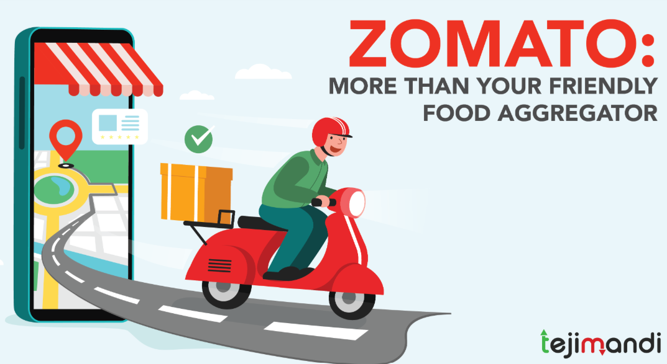
Zomato Delivery Analysis
-by Rohit kumar

Slide 2
Using SQL
Overview : This project analyzes a Zomato dataset with details of over 65,000 restaurants across Indian cities.
The data includes restaurant names, locations, ratings, cuisines, cost for two, order modes, table reservations, and famous dishes.
The aim is to explore customer preferences, pricing trends, and service patterns.
Insights from this analysis can help improve restaurant visibility, customer experience, and support Zomato’s growth strategies.
Key Insights & Findings
Most Popular Cuisines
North Indian, Chinese, South Indian, Fast Food.
Table Reservations
Yes: Reservation(5%)
No: Non- Reservation(95%)
Popular Areas & Cities
Delhi NCR has the highest concentration of restaurants.
Areas like Rohini have high density (876 restaurants)
Total Records: 65,535 restaurants.
Unique Restaurants: 56,617 (some are duplicates).
Cities Covered: Only 7, with Delhi NCR dominating.
Cuisine Diversity: 8,917
Average Rating: 3.5
75% of Restaurants: Under ₹500(Cost for Two)

Slide 3
Strategic Recommendations
Optimize High-Cost, Low-Performing Restaurants :
Restaurant such as Gol Bungalow – Taj Falaknuma Palace , Nostalgia at 1911 Brasserie – The Imperial, Bombay High – ITC Maratha have high cost but low performer .
Improve their service and attract more customers through marketing or consulting.
City and Area-Based Campaigns
Delhi NCR and Mumbai have high restaurant density. Focus marketing efforts in:
High-density areas for competition-based differentiation.
Low-density but high-cost areas for early mover advantage.
Cuisine-Based Promotion
Promote top cuisines like North Indian, Chinese, and South Indian in local languages and regional festivals.

Slide 4

Promote Online Orders in Offline-Dominant Regions
Use loyalty programs and first-order discounts to shift offline users to online.
Partner with High-Performing Low-Visibility Restaurants
Restaurants have very good ratings but don’t get many orders because people can’t find them easily. We can help them by showing them more on the app using Zomato Gold, banners, or sponsored ads, so more people notice and order from them.
Promote Best-Selling Dishes
Popular dishes like Biryani can be shown in ads, special menus, or combo offers to attract more customers and increase orders."

Slide 5



SQL QUERIES
Q1. Total no of restaurant Select count (Distinct restaurant name) as total_restuarant from zomato_food
Q2. Total no of cities Select count(distinct city) as Cities from zomato_food
Q3. Total no of cusine Select count(distinct cusine) from zomato_food

Slide 6
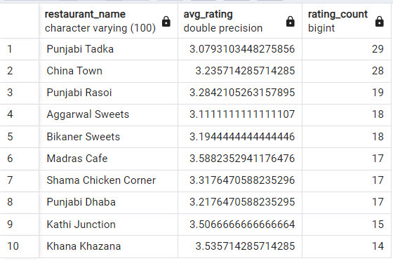
Q4. Average rating of Restaurant as per no of rating count Delete from zomato_food where rating is null Delete from zomato_food where rating_count is null
Select restaurant_name ,avg(rating) as avg_rating,count(RATING_COUNT)
as rating_count from zomato_food
Group by restaurant_name
Order by rating_count desc
Limit 10

Slide 7
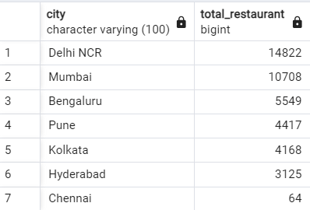
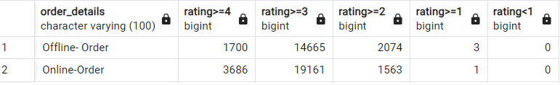
Q5. Total no of Restaurant as per city Select city, count(restaurant_name) as total_restuarant from zomato_food group by city order by total_restuarant desc
Q6. Rating segment as per order_details
Select order_details, sum(case when rating >=4.0 then 1 else 0 end) as "rating>=4", sum(case when rating >=3.0 and rating<4 then 1 else 0 end) as "rating>=3", sum(case when rating >=2.0 and rating<3 then 1 else 0 end) as "rating>=2", sum(case when rating >=1.0 and rating<2 then 1 else 0 end) as "rating>=1", sum(case when rating >=0.0 and rating<1 then 1 else 0 end) as "rating<1“ from zomato_food Group by order_details

Slide 8
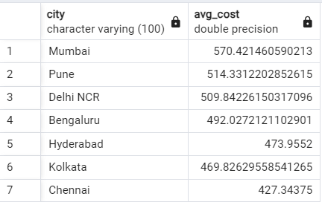
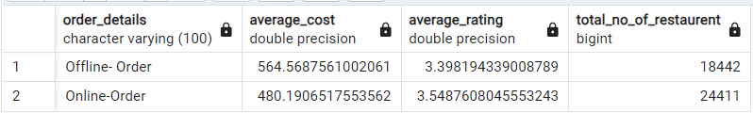
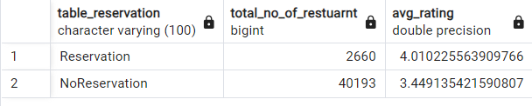
Q7. Average cost as per city wise select city, avg(cost_for_two) as avg_cost from zomato_food group by city order by avg_cost desc
Q8. Average average_rating, Average cost and Total Restaurants as per order_details Select order_details,avg(cost_for_two) as Average_cost,avg(rating) as Average_rating,count(*) as Total_no_of_restaurent from zomato_food group by order_details
Q9. Average rating , no of restaurant as per table_reservation
Select table_reservation,count(*) as total_no_of_restuarnt,avg(rating) as avg_rating from zomato_food
Group by table_reservation

Slide 9
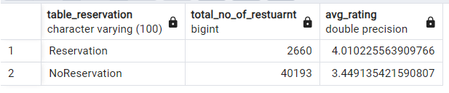
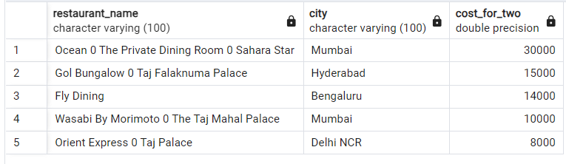
Q10. Most prefered cusine SELECT Cusine,avg(rating) as avg_rating , Count(*) AS total_count FROM Zomato_Food Group by Cusine Order by total_count desc Limit 10
Q11. Top 5 Most Expensive Restaurants (Based on Cost for Two) Select restaurant_name, city, Cost_for_two from Zomato_Food Order by Cost_for_two desc Limit 5

Slide 10
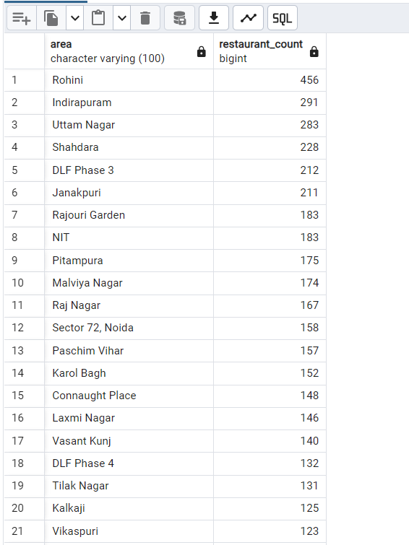
Q12. Total no of Restaurants per Area in a Specific City (e.g., Delhi NCR) Select Area, Count(*) AS Restaurant_Count from Zomato_Food Where City = 'Delhi NCR’ Group by area Order by Restaurant_Count desc

Slide 11

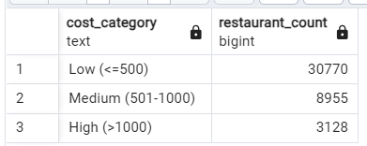
Q13. The Most Popular Dish SELECT Famous_food, Count(*) as Occurrences from Zomato_Food where Famous_Food IS NOT NULL Group by Famous_Food Order by Occurrences Desc Limit 1
Q14. Distribution of Restaurants Based on Cost for Two Select Case WHEN Cost_for_two <= 500 THEN 'Low (<=500)’ WHEN Cost_for_two BETWEEN 501 AND 1000 THEN 'Medium (501-1000)’ ELSE 'High (>1000)’ END AS Cost_Category, Count(*) AS Restaurant_Count from Zomato_Food Group by Cost_Category Order by Restaurant_Count DESC

